Slide 1
Project Proposal
-
BUTTON HOOK
Team 7
Pietro Sainaghi
Shubham Kiran Wani
Rodrigo Uribe
Huajing Zhao

Slide 2

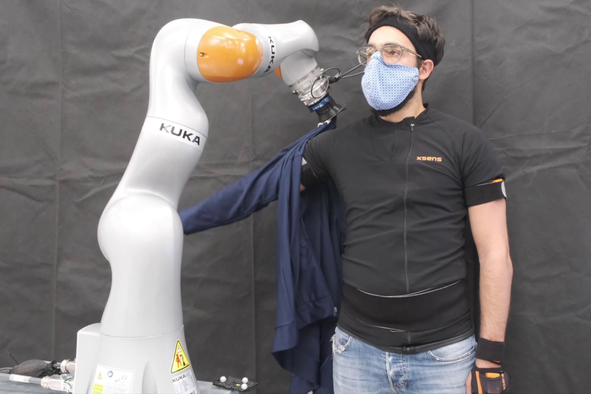
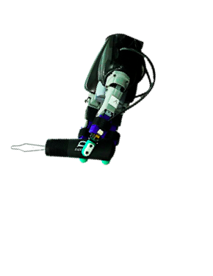
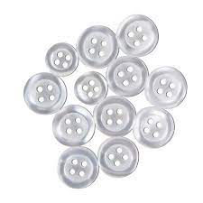
Motivation & Background
Robots have been used to dress physically impaired individuals
Issue: robots can only put the clothes on, but cannot buttoning them
We will use a buttonhook with tactile-driven control to perform the robot-assistive garment fastening task
Tactile sensors at robotic fingers provides slip detection
Tooltip and cloth fabrics/buttons has dynamic contacts
Need to distinguish effects at finger-tool and tool-environment interfaces
Team 7 - Button Hook
Project Proposal

Slide 3
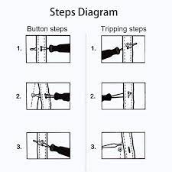
Functionality & Task
The tooltip can be modeled as an elastic beam
Simulate the hooktip dynamics
Lateral pulling and angular twisting motions
In contact with cloth fabrics and rigid buttons
A novel contribution to tool-manipulation: finger-tool v.s. tool-environment interactions
Model the relative motions and dynamic contact of tooltip
Assist the tactile-driven slip and shear force detection
Team 7 - Button Hook
Project Proposal
Notes:
The tooltip of button hook is of slender and compliant structure that can be modeled as an fixed-ended elastic beam

Slide 4
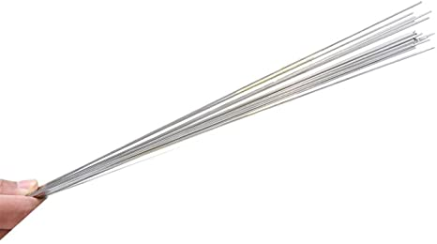
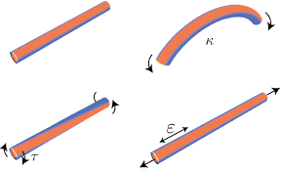
Project Overview
Simulate using 3-d rod model
Structure is slender and long enough for assumption to be valid
Tension, Torsion, Bending
Use ‘zeros’ of torsional springs to create hook shape
Simulate deformation and forces:
Going through button hole
Hooking button
Alignment twisting motion
Unhooking button
Team 7 - Button Hook
Project Proposal

Slide 5
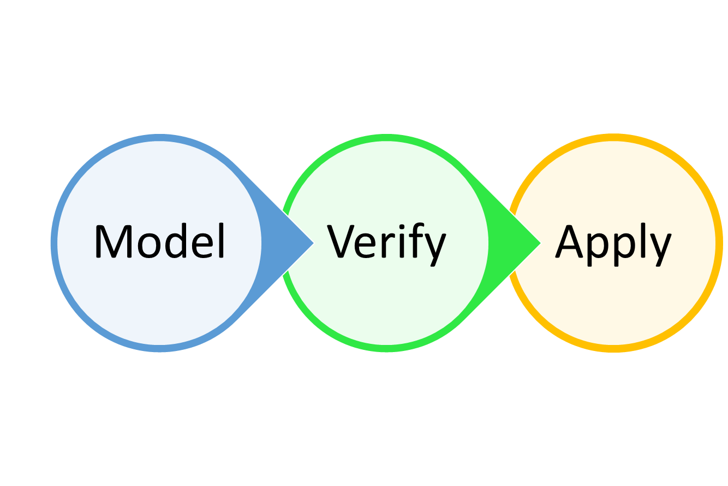
Objectives
Construct a simulation of the button hook.
Verify that we accurately depict the current design.
Adjust the parameters for optimal performance.
Material Selection (Material Properties)
Geometry Design (Curvature, Rod Geometry)
Team 7 - Button Hook
Project Proposal

Slide 6
Planned Deliverables
Define button hook as rod object
Test interactions with basic forces
Define boundary conditions for various interactions
Go through button hole
Hook Button
Twist motion to align button
Unhook button
Simulate interactions
Construct motion sequence
Compare different geometries and material properties
Team 7 - Button Hook
Project Proposal

Slide 7
Thank you!
-
Any questions?

